Slide 1
Sleep Spindles Detection
Emeagi, Najafi, Khajepur, Izadipour

Slide 2
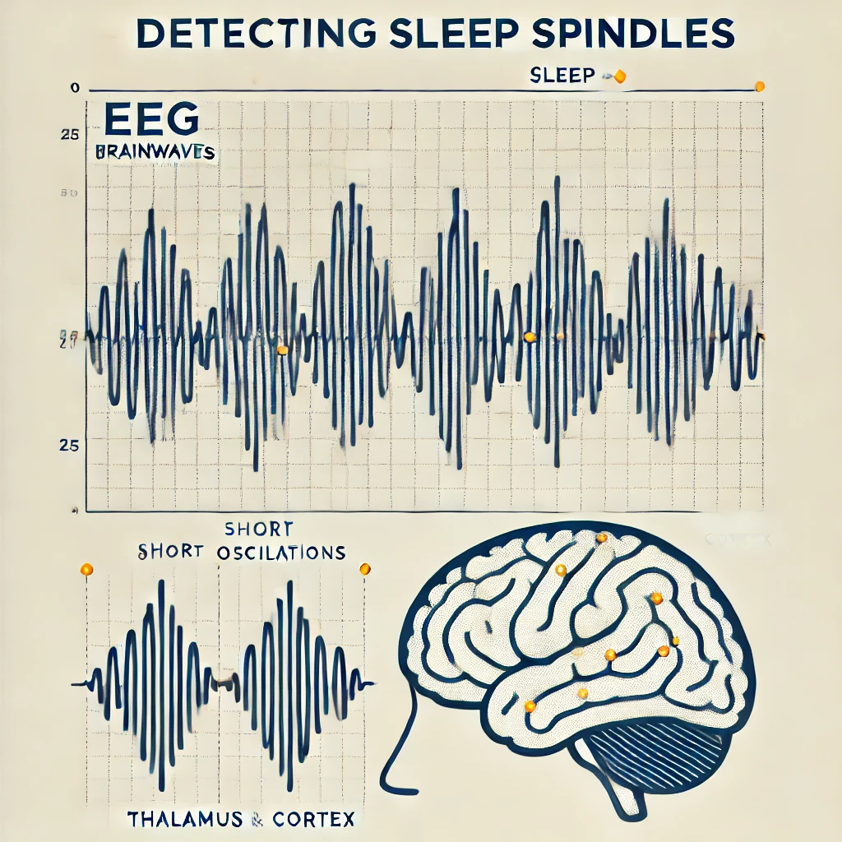
Team Members and Roles
Emeagi Michael - Project Owner
Khajepur Arash - Development Lead
Najafi Nasim - Scientific Lead
Izadipour Ali - Marketing Lead

Slide 3
Define function
def read_signal(file_name, win_s, win_width):
def detect_spindles(eeg, fs):
def calculate_metrics(detected_spindles, manual_annotation):
def plot_spindles(eeg, fs, spindles, ann_1_win)

Slide 4
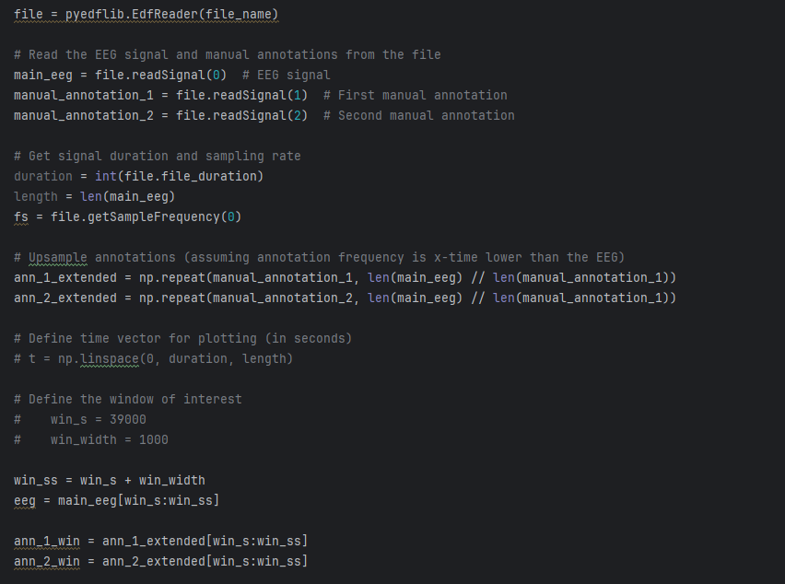
def read_signal(file_name, win_s, win_width):

Slide 5
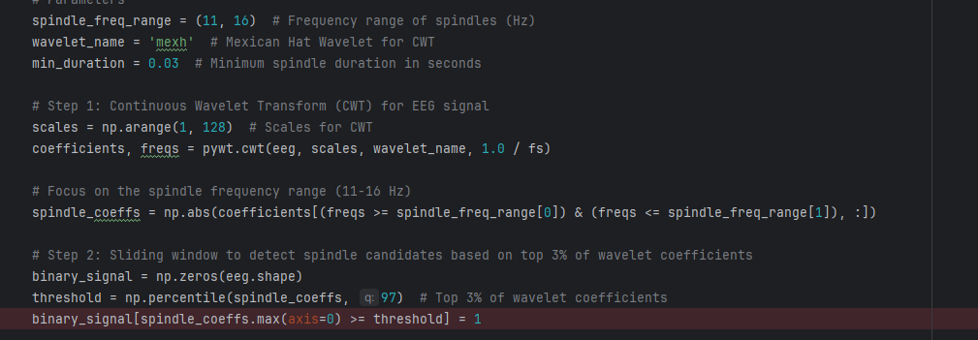
def detect_spindles(eeg, fs):

Slide 6
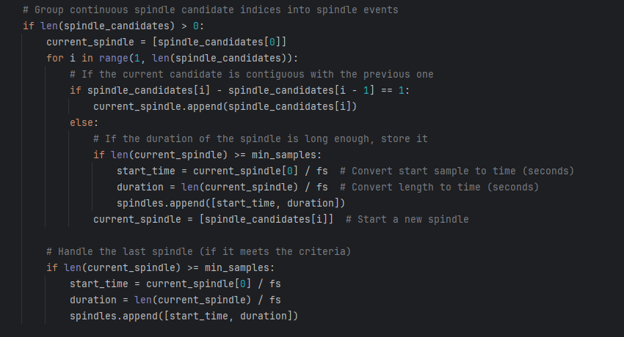
def detect_spindles(eeg, fs):

Slide 7
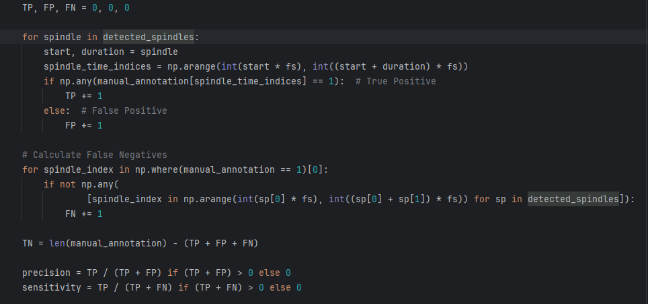
def calculate_metrics(detected_spindles, manual_annotation):

Slide 8
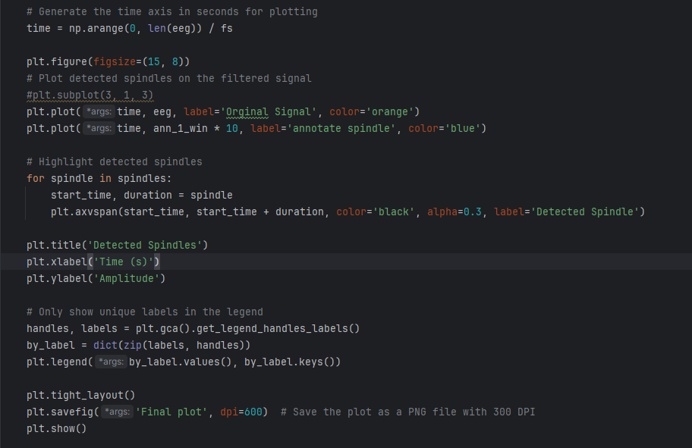
def plot_spindles(eeg, fs, spindles, ann_1_win)

Slide 9
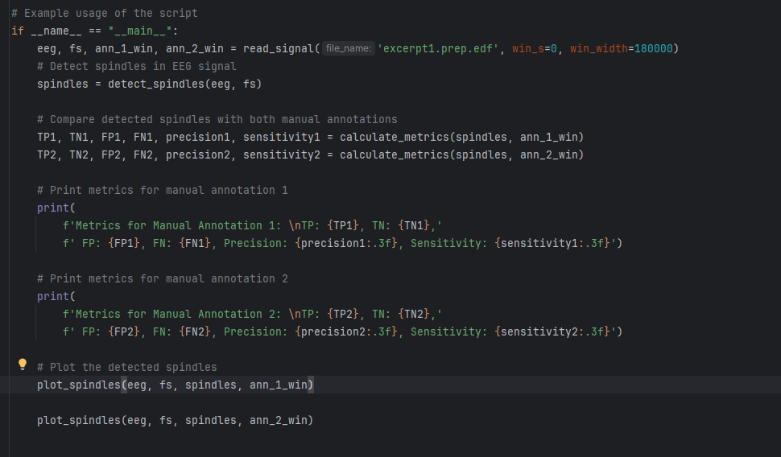
How to use this library?

Slide 10
What is the output?
Length of EEG signal: 180000, Sampling rate: 100.0 Hz
Length of interested window EEG signal: 180000
Metrics for Manual Annotation 1:
TP: 56, TN: 175207, FP: 636, FN: 4101, Precision: 0.081, Sensitivity: 0.013
Metrics for Manual Annotation 2:
TP: 162, TN: 168388, FP: 530, FN: 10920, Precision: 0.234, Sensitivity: 0.015

Slide 11
What is the output?

Slide 12
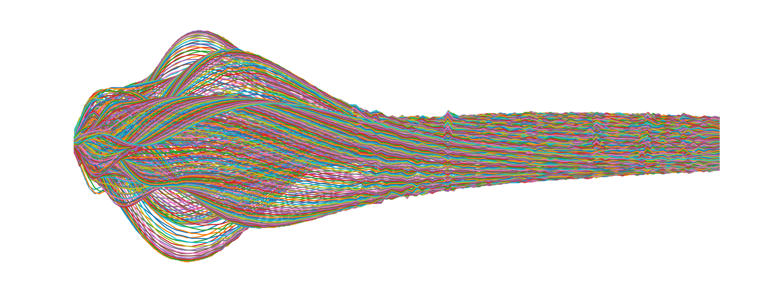
QUESTIONS?

Slide 13
Thank you for your attention

